Slide 1
Getting Started with Open Source Accessibility Projects
March 21, 2018
By Marc Johlic and Sharon Snider

Slide 2
Why contribute to open source projects?

Slide 3
Our Mission
“To help the world become more accessible by enabling designers and developers through Open Source.”

Slide 4
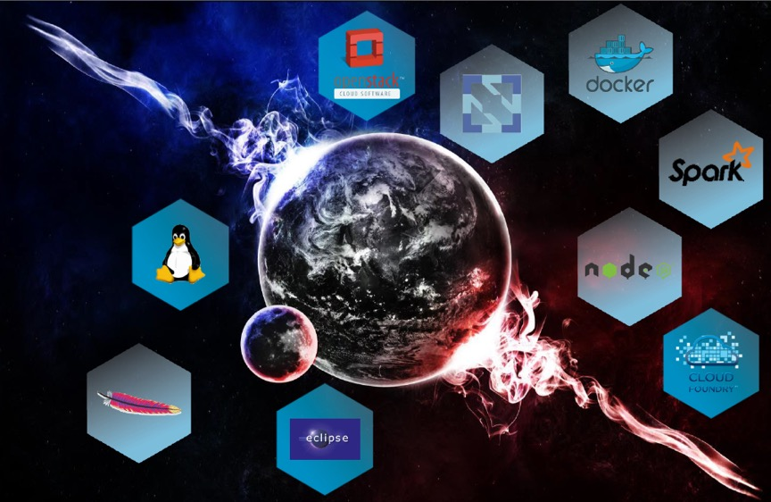
Brief History of Open Source by IBM
Notes:
IBM has been a leader in open source since the late 1990s. IBM legitimized the use of open source in the enterprise in 2000 when we set up the Linux Technology Center, and become a key supporter of Linux and the Linux Foundation.
In 2001, I joined IBM’s Linux Technology Center as an Accessibility Lead. Our mission was to contribute to the Linux open source community to understand what accessibility was built-in to the Linux operating system and to contribute accessibility guidance to the open source community.
In 2005 IBM announced that it was contributing software to the Mozilla Foundation's Firefox Web browser to make it easier for more users -- including those with visual and motor impairments -- to access and navigate the Web. In addition to contributing code that makes it possible for Web pages to be automatically narrated or magnified, and to better navigated with keystrokes rather than mouse clicks, IBM contributed Dynamic Hypertext Markup Language (DHTML) accessibility technology.
The successful deep collaboration with other industry leaders on Linux led IBM to again work with others to establish the Apache Software Foundation and the Eclipse Foundation. We went even further with Eclipse by providing significant code contributions and dedicated technical resources. On a broad scale, IBM’s participation in these and hundreds of other projects and communities set the tone for open source adoption among the enterprise.

Slide 5
How to Get Started

Slide 6
Getting Started
Know the ropes
Be observant
Learn to be a good community member
Be courteous
Start small, build trust
Find a project
Have Fun!!
Notes:
Know the ropes, each community has its own way of doing things. Look for information on contributing on the community's web site or GitHub repository. In most major communities there is information on how to join and contribute. Its important for you to follow the instructions and ask for help if you need it.
Be observant first and foremost before entering the fray. Your contribution matters to volunteers who will be reviewing your code, or issues. Make contributions that are small, complete, and easily reviewed in a single sitting. You’ll find your permission builds as you help the community reach its goals.
Learn to be a good community member. Open source communities respect your ability to contribute and document improvements. Treat others the way you want to be treated. People love to be respected and they appreciate professional behavior.
Be courteous, most significant communities have a code of conduct. The best are very friendly and most people go out of their way to provide helpful reviews. Start small, build trust. Contribute small changes for a long time to understand the process before attempting to make large changes.
Find a project you enjoy and take the steps to start contributing.
And most of all have fun!! Next, we’ll discuss ways to contribute.

Slide 7
Ways to Contribute
Search through an Open Source project’s “Issues” and find issues you can fix
Accessibility Verification Testing results using an automated tool
Report an issue that you find while using Open Source applications or reading documentation
Write documentation for a project including the accessibility features of an application
Help organize a hackathon or event
Maintain the projects Web content and help make it accessible at the same time
Accessible sample code and widgets
Notes:
Search through an Open Source project issues and find issues you can fix
Accessibility Verification Testing results using an automated tool
Report an issue that you find while using Open Source applications or reading documentation
Write documentation for a project including the accessibility features of an application. Even proof-reading the project’s existing documentation and providing spelling and grammar corrections can be a great contribution – and and easy way to get started
Help organize a hackathon or event
Maintain the projects Web content and help make it accessible at the same time
Accessible sample code and widgets

Slide 8
Where to Contribute
How to contribute to an Open Source project on GitHub https://egghead.io/courses/how-to-contribute-to-an-open-source-project-on-github
Finding Open Source Projects on GitHub https://help.github.com/articles/finding-open-source-projects-on-github/
Verified Accessibility Samples (Va11yS) https://github.com/IBMa/Va11yS
What open source project should I contribute to? https://blog.kentcdodds.com/what-open-source-project-should-i-contribute-to-7d50ecfe1cb4
A11y Project https://github.com/a11yproject/a11yproject.com/blob/gh-pages/CONTRIBUTING.md
Notes:
On this slide we have listed a few web sites that can help you find an open source project that you might be interested in. One of the tools frequently used by open source projects is a GitHub repository. The repository is where code is stored, issues are tracked and contribution information can be found. You should get familiar with GitHub and the tools used to create, clone and update a GitHub repository. egghead.io has a course you can take called “How to contribute to an Open Source project on GitHub” With this series, you’ll be equipped with the the tools, knowledge, and understanding you need to be productive and contribute to the wonderful world of open source projects.
The next link on this slide is to GitHub’s help web page on “Finding Open Source Projects on GitHub”. You can use this site to Explore the GitHub collections of curated content related to a particular field, find curated topic pages, and stay up-to-date with currently trending repositories.
IBM Accessibility also has an open source GitHub repository of “Verified Accessible Samples” (Va11yS) that you can contribute to. This site provides code samples to help developers and testers understand how different web components operate with assistive technology (AT) on desktop and mobile devices. Each sample has the tested components along with results by operating system. Kent C. Dodd’s blog provides a lot of good information on getting started with open source and it includes suggestions on how to find an open source project.
And the last link on this slide is to the A11y Project which is a community driven effort to make web accessibility easier. Their contributing information in GitHub lists all the various ways to contribute to their project including GitHub maintenance, article writing and pattern submissions.

Slide 9
Common Tools
Repository
GitHub
Bitbucket
Git GUI Clients
GitHub Desktop
Fork
SourceTree
Tower
GitKraken
IDE
Visual Studio Code
Sublime Text
Brackets
Atom
Accessibility Testing
Dynamic Assessment Plug-in (DAP)
Lighthouse (Chrome Dev Tools)
aXe
Automated Testing
Automated Accessibility Tester (AAT)
aXe-core
Karma, Selenium
Travis CI
Notes:
Repository: Where projects are stored.
GitHub vs Bitbucket
Both are free
GitHub unlimited FREE repositories – 1 free private repository. You pay for additional private repositories
BitBucket unlimited FREE private repositories. Additional charges for other services
GitHub https://github.com/
GitHub Desktop Client https://desktop.github.com/
Visual Studio Code https://code.visualstudio.com/
Sublime Text https://www.sublimetext.com/
Brackets http://brackets.io/
Atom https://atom.io/
Dynamic Assessment Pluging (DAP) https://aat.mybluemix.net/
Automated Accessibility Tester (AAT) https://aat.mybluemix.net/

Slide 10
Demo

Slide 11
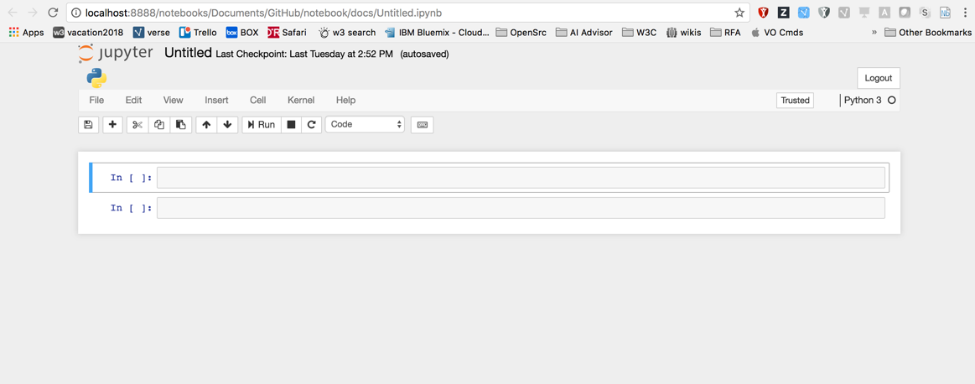
Jupyter Notebook Issue
Notes:
In this example we are contributing to Jupyter Notebook. It is a browser-based tool for interactive authoring of documents which combine explanatory text, mathematics, computations and their rich media output.
This slide displays a screenshot of a newly created Jupyter Notebook. There is a blue and yellow image of the current kernel logo located under the Jupyter logo that is missing alt text. The violation was found after a running an accessibility scan using the Dynamic Assessment Plugin (DAP) Chrome extension.

Slide 12
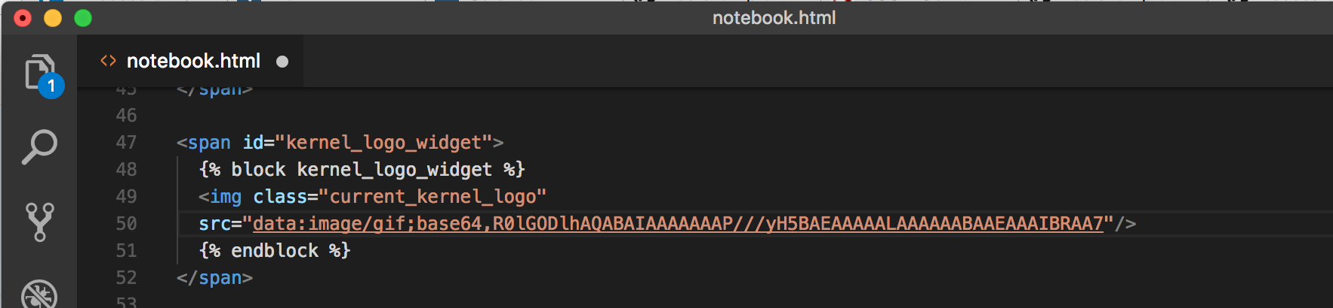
Jupyter Notebook File
On line 49 we can see that the image is miss alt text.
Notes:
Using Visual Studio code the issue has been located in the notebook.html template on line 49. As you can see the img tag does not have alt text attribute to indicate the alternative text for the image.

Slide 13
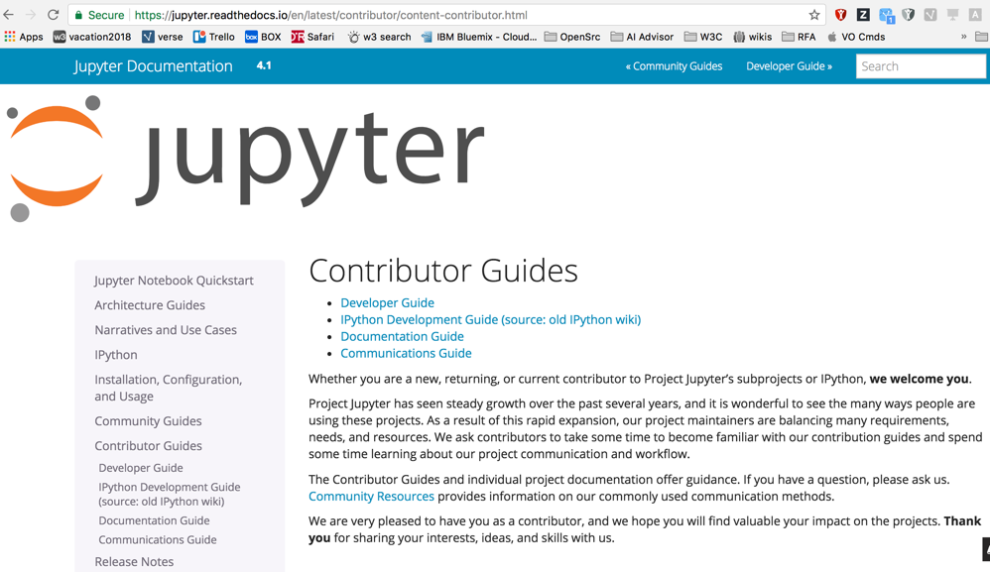
Jupyter Notebook Contributor
Notes:
This is a screen shot of the Jupyter Notebook Contributor Guide. After reviewing the information on how to contribute and following the instructions provided, I entered the issues in the Jupyter Notebook GitHub repository. Notice that there are various guides contributor guides for Developers, Documentation and Communications.

Slide 14
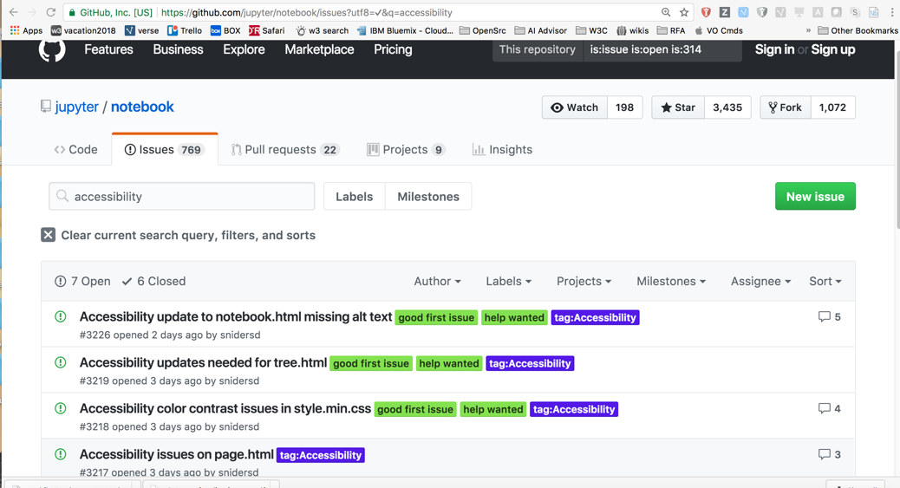
Jupyter Notebook GitHub Issue List
Notes:
This is a screenshot of GitHub displaying the Accessibility update to notebook.html missing alt text issue #3226. After it was entered the repository owner assigned it the labels of ”good first issue”, “help wanted”, and “tag:accessibility. It also includes the date it was open and the number of user comments that are associated with the issue.

Slide 15
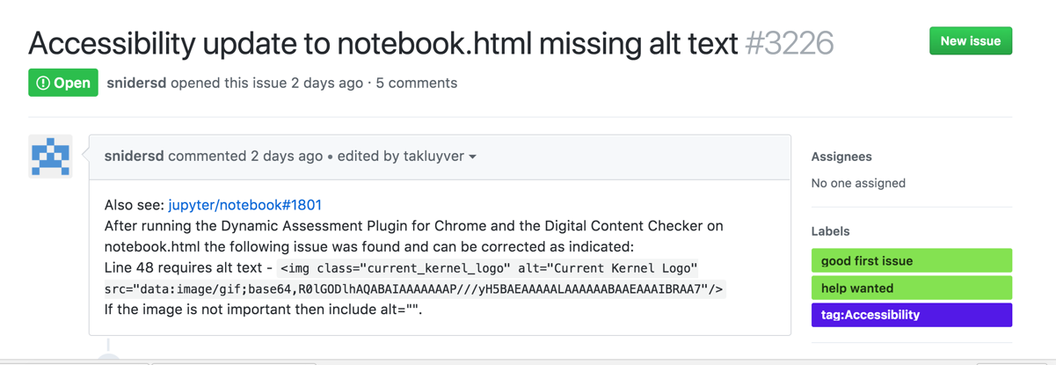
Jupyter Notebook Accessibility Issue
Notes:
In this screenshot you can see the type of information that is included when reporting a new issue. I added Accessibility to the title so they know its an accessibility violation. The detailed information explains how the violation was found, the file that has the issue and the code that needs to be fixed. After the labels are added by the admin, any project contributor can volunteer to fix the issue. Email notifications are sent anytime the issue changes so its important to read all comments carefully to ensure no additional information is needed to complete the task.

Slide 16
Live Demo
Let’s Do Something!
During the live session at CSUN we contributed to the “Accessibility Interview Questions” open source project on GitHub. Below are the links to the project’s repository, the Pull Request we opened, and the changes we submitted:
https://github.com/scottaohara/accessibility_interview_questions
https://github.com/scottaohara/accessibility_interview_questions/pull/9
https://github.com/scottaohara/accessibility_interview_questions/pull/9/files

Slide 17
Va11yS – Verified Accessibility Samples
ibma.github.io/Va11yS/ | github.com/IBMa/Va11yS
~200 WCAG Techniques
HTML
ARIA
General
React
Test platforms
Windows / JAWS
iOS / VoiceOver
Android / Talkback
Travis CI, aat/karma
73 Stargazers / 16 Forks
2018 Plans
More samples (React, Angular, CSS, Swift etc.)
Integrate into DAP / aat rulesets
WCAG 2.1 Techniques

Slide 18
Va11yS – Listing of Samples

Slide 19
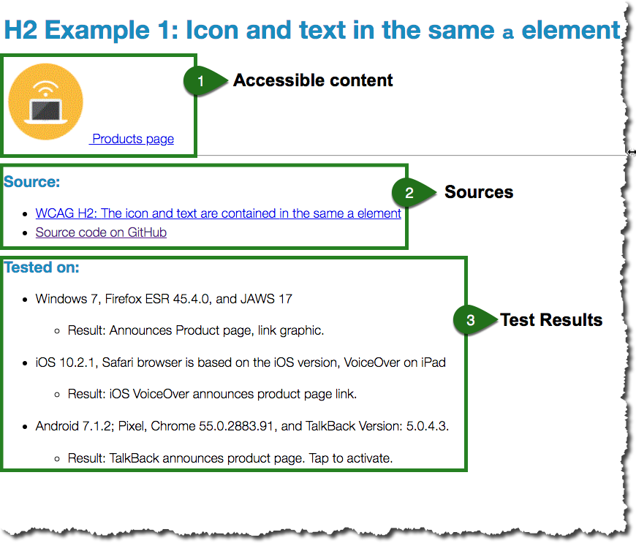
Va11yS – Sample Page

Slide 20
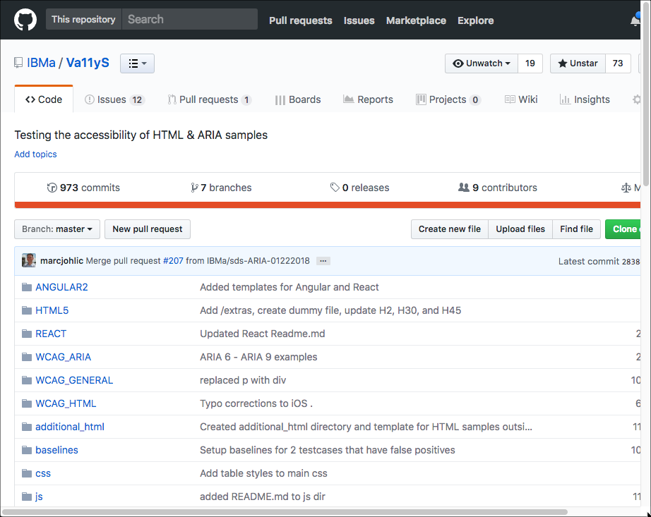
Va11yS – GitHub Repository

Slide 21
Va11yS – Automated Accessibility Testing
Notes:
This is a view of IBM’s Automated Accessibility Tester running on pull request to the Va11yS repository. Travis CI is used along with Karma and @ibm/aat to execute the test. Results show that 172 pages were checked and passed in 13 seconds.

Slide 22
Resources - Common Tools
Repository
GitHub - github.com
Bitbucket
Git GUI Clients
GitHub Desktop - desktop.github.com
Fork - git-fork.com
SourceTree - www.sourcetreeapp.com
Tower
GitKraken
IDE
VS Code - code.visualstudio.com
Sublime Text - www.sublimetext.com
Brackets - brackets.io
Atom - atom.io
Accessibility Testing
Dynamic Assessment Plug-in (DAP) - aat.mybluemix.net
Lighthouse (Chrome Dev Tools)
aXe
Automated Testing
Automated Accessibility Tester (AAT) - aat.mybluemix.net
aXe-core
Karma, Selenium
Travis CI
Notes:
Repository: Where projects are stored.
GitHub vs Bitbucket
Both are free
GitHub unlimited FREE repositories – 1 free private repository. You pay for additional private repositories
BitBucket unlimited FREE private repositories. Additional charges for other services
GitHub https://github.com/
GitHub Desktop Client https://desktop.github.com/
Visual Studio Code https://code.visualstudio.com/
Sublime Text https://www.sublimetext.com/
Brackets http://brackets.io/
Atom https://atom.io/
Dynamic Assessment Pluging (DAP) https://aat.mybluemix.net/
Automated Accessibility Tester (AAT) https://aat.mybluemix.net/

Slide 23
Resources
An Open Source Etiquette Guidebook by Kent Dodds and Sarah Drasner
https://css-tricks.com/open-source-etiquette-guidebook/
How open source licenses work and how to add them to your projects
https://medium.freecodecamp.org/how-open-source-licenses-work-and-how-to-add-them-to-your-projects-34310c3cf94
JAWS Wide Open – Paciello Group
https://developer.paciellogroup.com/blog/2017/10/jaws-wide-open/
Accessibility Interview Questions (Our demo / souvenier)
https://github.com/scottaohara/accessibility_interview_questions
Noopkat – Suz Hinton
http://noopkat.com/
Becoming an Open Source Project Maintainer
https://kentcdodds.com/post/becoming-a-maintainer/
Verified Accessibility Samples (Va11yS)
https://ibma.github.io/Va11yS/

Slide 24
Thank You!
Questions?
Download this presentation: bit.ly/csun2018opensource

Slide 25
Other IBM sessions at CSUN 2018
Wednesday |  | Topic | Presenter | Location
09:00 AM | LAW-008 | VPAT 2.0 Conformance Reporting Essentials | Mary Jo Mueller, IBM Glenn Meyer, HP | Torrey Hills AB 3rd Floor, Seaport
10:00 AM | EMP-027 | Enabling ASD Students for Greater Success in the Workplace | Yuri Kobayashi, IBM | Cortez Hill C, 3rd Floor, Seaport
10:00 AM | LAW-040 | Harmonized Accessibility Testing for WCAG | Mary Jo Mueller, IBM Wilco Fiers, Deque Systems Shadi Abou-Zahra, W3C | Torrey Hills AB, 3rd Floor, Seaport
11:00 AM | EMP-037 | Getting Started with Open Source Accessibility Projects | Marc Johlic, IBM Sharon Snider, IBM | Cortez Hill C, 3rd Floor, Seaport
Thursday |  | Topic | Presenter | Location
09:00 AM | EDU-110 | Working with Color Blindness, Web, Mobile and the Real World | Cam Beaudoin, IBM | Balboa C, 2nd Floor, Seaport
09:00 AM | EMP-059 | Tools, Techniques, and Technologies for Creating Inclusive Workplaces | Erich Manser, IBM Lou Orslene, JAN | Cortez Hill C, 3rd Floor, Seaport
10:00 AM | LAW-011 | Accessibility Analysis and Automation with Deep Learning | Charu Pandhi, IBM Will Scott, IBM | Golden Hill AB, 3rd Floor, Seaport

Slide 26
Other IBM sessions at CSUN 2018
Friday |  | Topic | Presenter | Location
09:00 AM | EMP-051 | Digital Accessibility Conformance – IBM Approaches and Best Practices | Phill Jenkins, IBM Lori Southworth, IBM | Torrey Hills AB, 3rd Floor, Seaport
11:00 AM | EDU-002 | AI: Eliminating the Societal Impact of Learning and Cognitive Disabilities | Will Scott, IBM Ram Ramachandran, IBM Stephanie Martin, CLE | Gaslamp AB, 2nd Floor, Seaport
02:20 PM | EDU-043 | Lessons Learned in Corporate Accessibility Training | Lori Southworth, IBM Tamas Babinszki, IBM Marc Johlic, IBM | Balboa AB, 2nd Floor, Seaport
02:20 PM | LAW-004 | World Tour of Accessibility Policy and Standards | Mary Jo Mueller, IBM | Golden Hill AB, 3rd Floor, Seaport

